Slide 1
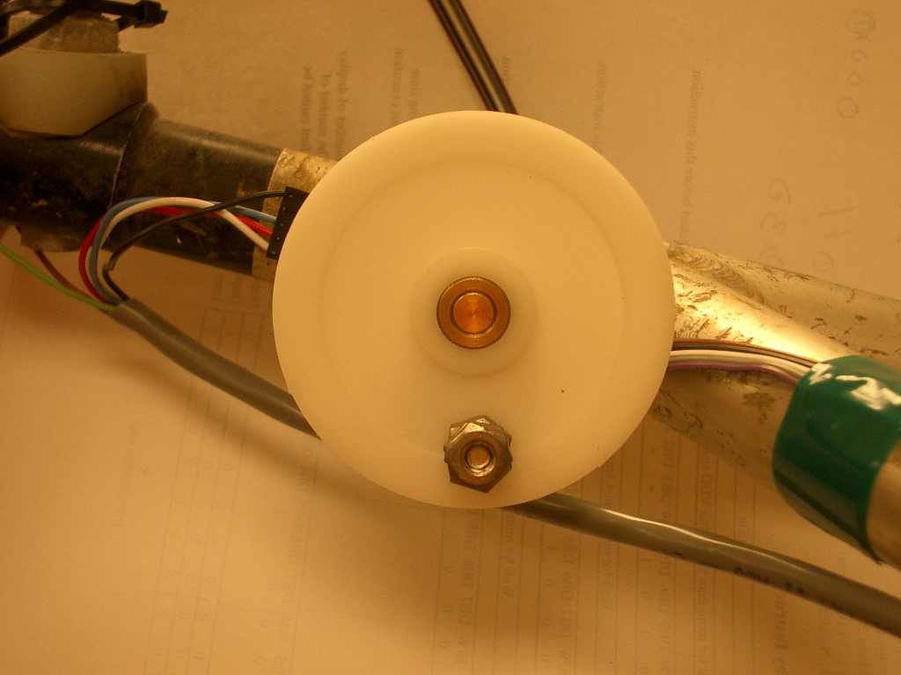
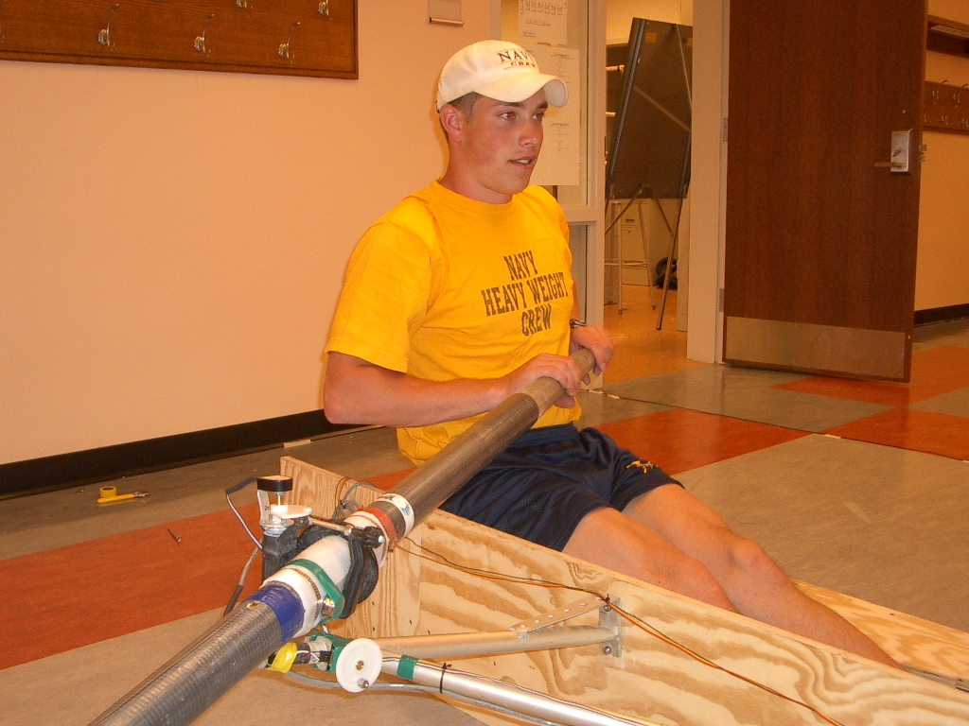
Trial 2 – Successful – Shell Tilt Sensor
Experimenting with the Optical Encoder for oar position, we decided to use it for shell tilt as well
Using a weight and the force of gravity, we can get a reading as to the angle of the shell
Optical Encoder
ENCL-6

